Slide 1
INTRODUCTION TO C++

Slide 2


Slide 3

What is a Computer?
An electronic device that stores, retrieves, and processes data, and can be programmed with instructions. A computer is composed of hardware and software, and can exist in a variety of sizes and configurations.

Slide 4
The Four Main Functions of Computers:-
A computer is designed for:
Data entry(Initial function i.e input device)
Data processing(CPU)
Information output(viewed via display monitor)
Data and information storage(hard disk drive)

Slide 5
CHARACTERISTICS OF COMPUTERS
The various characteristics of computers are as follows
Speed: Speed is the most important characteristics of computer .Computer having more speed to perform jobs instantaneously.
2. Accuracy: The computers are perfect, accurate and precise. Accuracy signifies the reliability of the hardware components of computers.
3. Automatic: A computer works automatically, once programs are stored and data are given to it, constant supervision is not required.
4. Endurance: A computer works continuously and will not get tired and will not suffer from lack of concentration.
5. Reduction of cost: Though initial investment may be high, computer substantially reduces the cost of transaction.

Slide 6
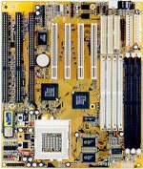
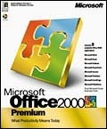
Hardware & Software
The term hardware refers to the physical components of your computer such as the system unit, mouse, keyboard, monitor etc.
The software is the instructions that makes the computer work.

Slide 7
HARDWARE COMPONENTS

Slide 8
BASIC COMPUTER ORGANIZATION OR HARDWARE COMPONENTS:
A standard fully featured desktop configuration has basically four types of featured devices or handware components
1. Input Devices
2. Output Devices
3. Memory
4. Storage Devices

Slide 9
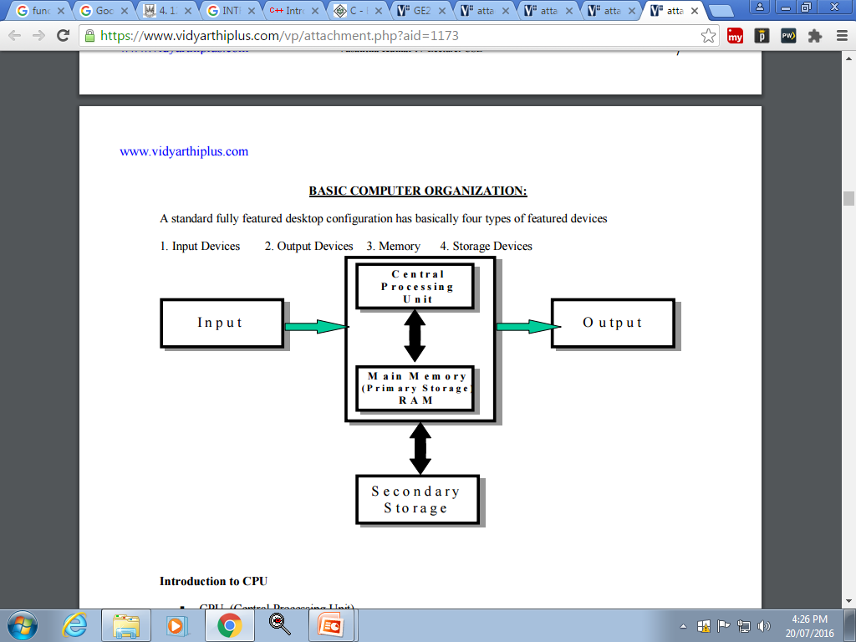

Slide 10
TYPES OF RAM:
There are two types of RAM used in PCs –
Dynamic RAM (DRAM):
The information stored in Dynamic RAM has to be refreshed after every few milliseconds otherwise it will get erased.
DRAM has higher storage capacity and is cheaper than Static RAM.
Static RAM (SRAM):
The information stored in Static RAM need not be refreshed, but it remains stable as long as power supply is provided.
SRAM is costlier but has higher speed than DRAM.

Slide 11
SOFTWARE COMPONENT

Slide 12
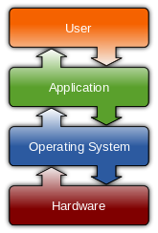
Operating system
An operating system (OS) is system software that manages computer hardware and software resources and provides common services for computer programs E.g. Windows 10 ,Linux etc.

Slide 13
Applications software
An application program is the type of program that you use once the operating system has been loaded.
Examples include word-processing programs, spreadsheets and databases etc

Slide 14
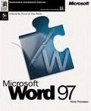
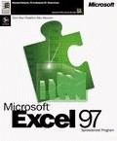
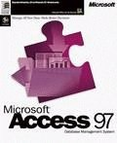
Software Component
Application Software
Word processing applications
Microsoft Word
WordPerfect
Spreadsheets
Microsoft Excel
Database
Microsoft Access

Slide 15
Information Network
LAN
A LAN (Local Area Network) is a system whereby individual PCs are connected together within a company or organization
WAN
A WAN (Wide Area Network) as the name implies allows you to connect to other computers over a wider area (i.e. the whole world).

Slide 16

Uses of Computer
Computers in Daily Life
Accounts
Games
Educational
On-line banking
Smart ID cards
Supermarkets
Working from home (Tele-working)
Internet

Slide 17
PROGRAMMING LANGUAGE

Slide 18
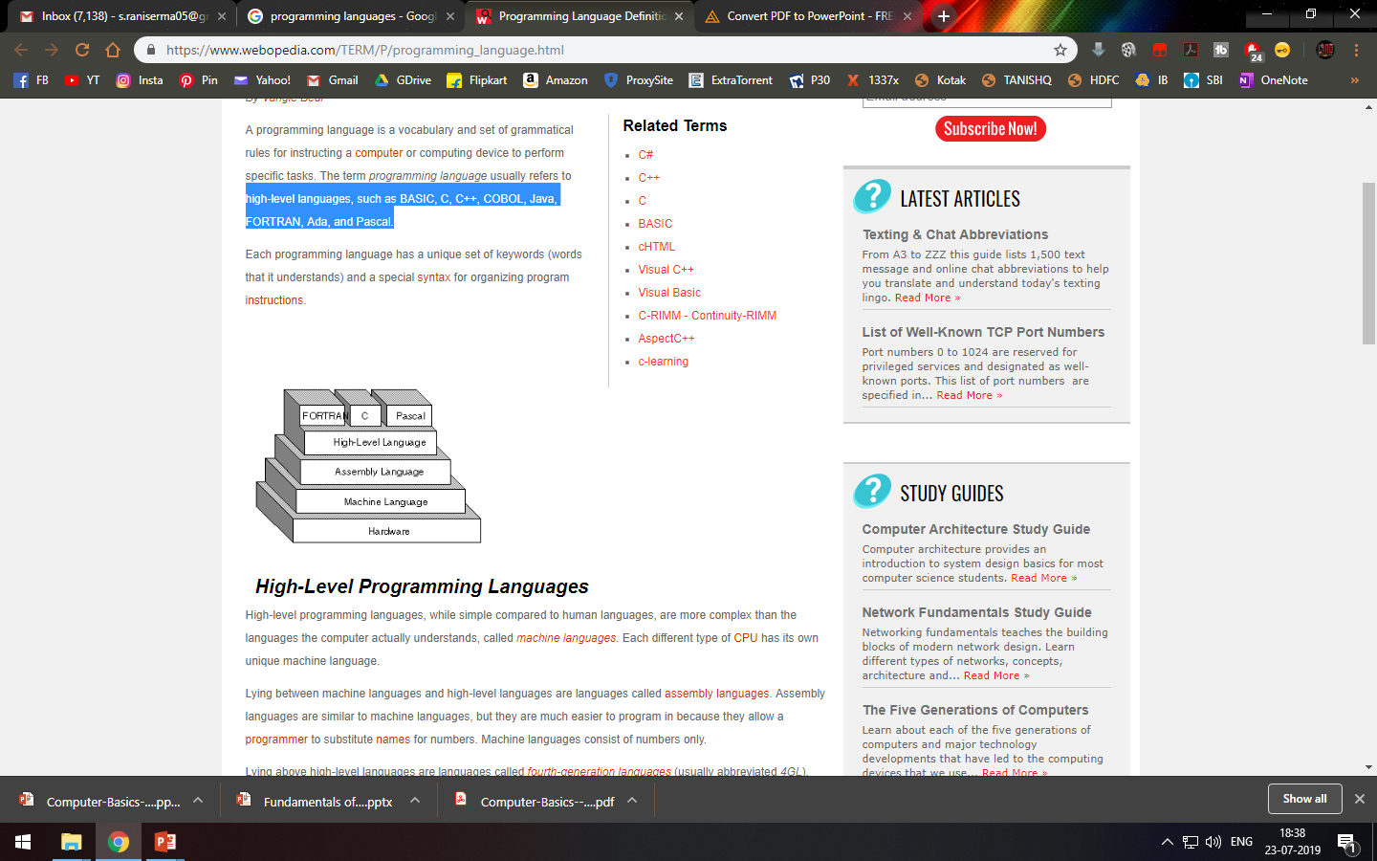
Programming language
A programming language is a set of grammatical rules for instructing a computer or computing device to perform specific tasks.
It is an high-level languages, such as BASIC, C, C++, COBOL, Java, FORTRAN, Ada, and Pascal.

Slide 19
Two types of Programming language:
1. Procedural Programming
2. Object Oriented Programming:

Slide 20
Procedural Programming:
Procedural Programming can be defined as a programming model which is derived from structured programming, based upon the concept of calling procedure.
There is no access specifier in procedural programming i.e. public, private etc.
Adding new data and function is not easy.
Procedural programming does not have any proper way for hiding data so it is less secure.
Examples: C, FORTRAN, Pascal, Basic etc.

Slide 21
Object Oriented Programming:
Object oriented programming can be defined as a programming model which is based upon the concept of objects. Objects contain data in the form of attributes(variables or data) and code in the form of methods(functions).
Object oriented programming have access specifiers like private, public etc.
Adding new data and function is easy.
Object oriented programming provides data hiding so it is more secure.
Examples: C++, Java, Python, C# etc.

Slide 22
OVERVIEW OF C++
C++ is a multi-paradigm that supports object-oriented programming.
It is an high level language →developed by Bjarne Stroustrup (Bell Labs, 1983)
started as extension to C by adding new features
It is used for programers to develop computer software.

Slide 23
Structure of C++
Header File
Main function
Variable declarations or code
Note:
Every statement ends with ;(semicolon).
Main function or function start and end with {} (curly braces)

Slide 24
Header File
Header files contain definitions of Functions and Variables, which is imported or used into any C++ program
E.g.
#include<iostream.h>
iostream stands for standard input output stream.
This header file contains definitions to objects like cin(input) and cout(output).
Explanation:
#include is pre-processor in C++
Header file have an extension ".h"

Slide 25
2. Main function
void main( )
{
}
3. Code or Variable declaration

Slide 26
E.g. :
Write a c++ program to display “Welcome to Bioinformatics” as output on screen
#include<iostream.h>
void main()
{
cout<<“Welcome to Bioinformatics”
}
Output:
Welcome to Bioinformatics

Slide 27
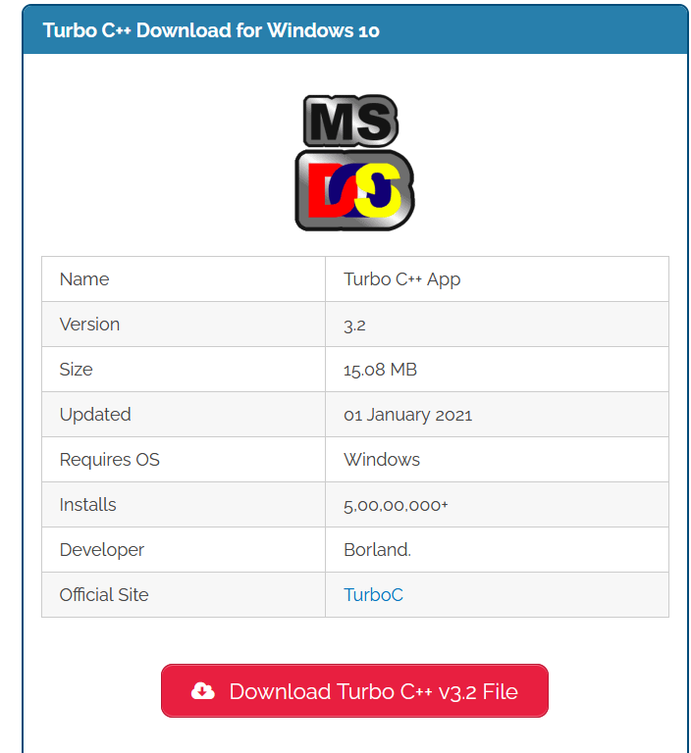
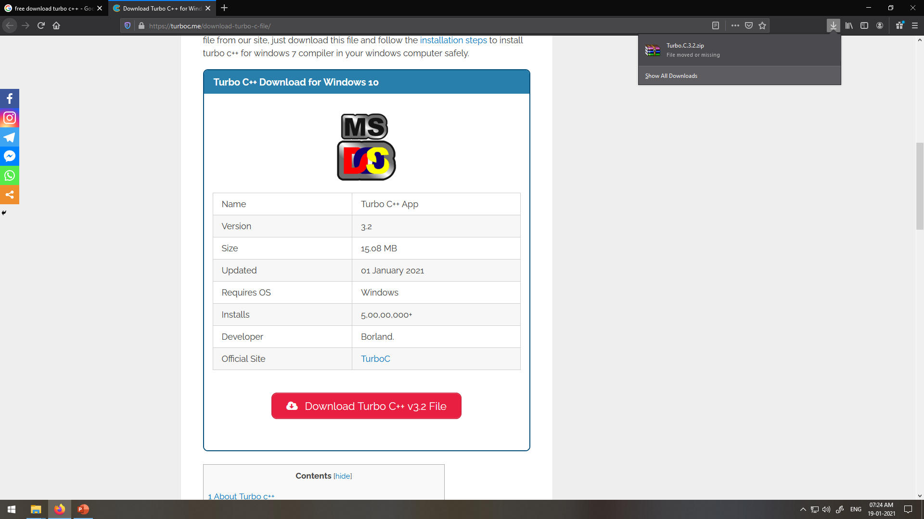
Install Turbo C++
https://turboc.me/download-turbo-c-file/

Slide 28
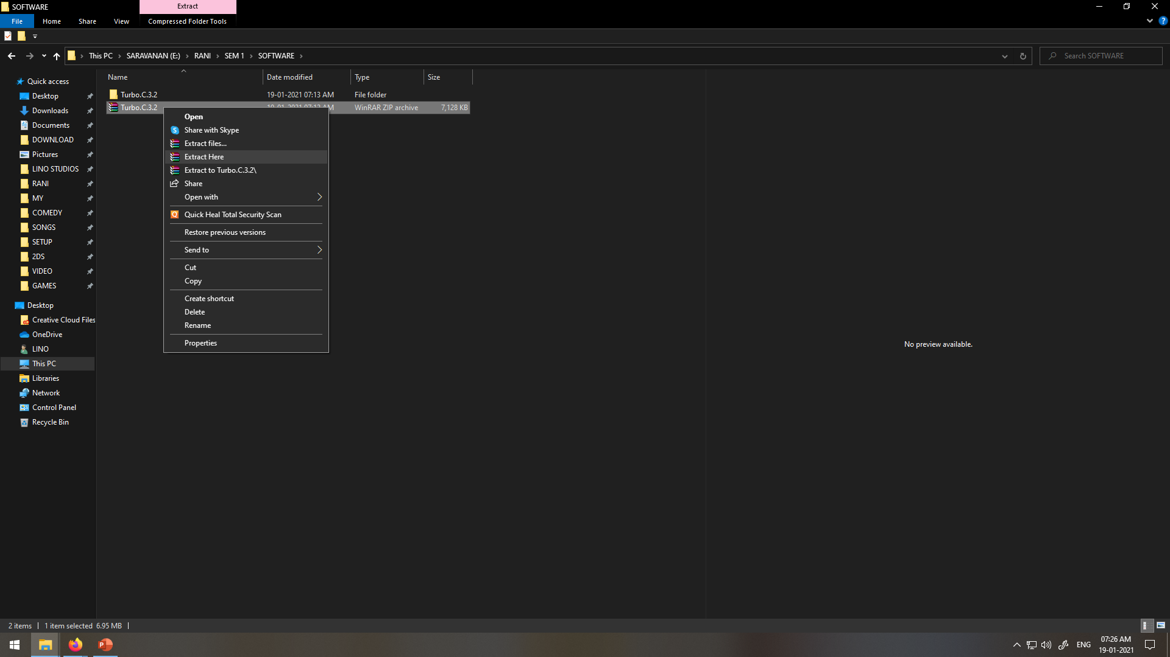
Right click on file→click on extract file

Slide 29
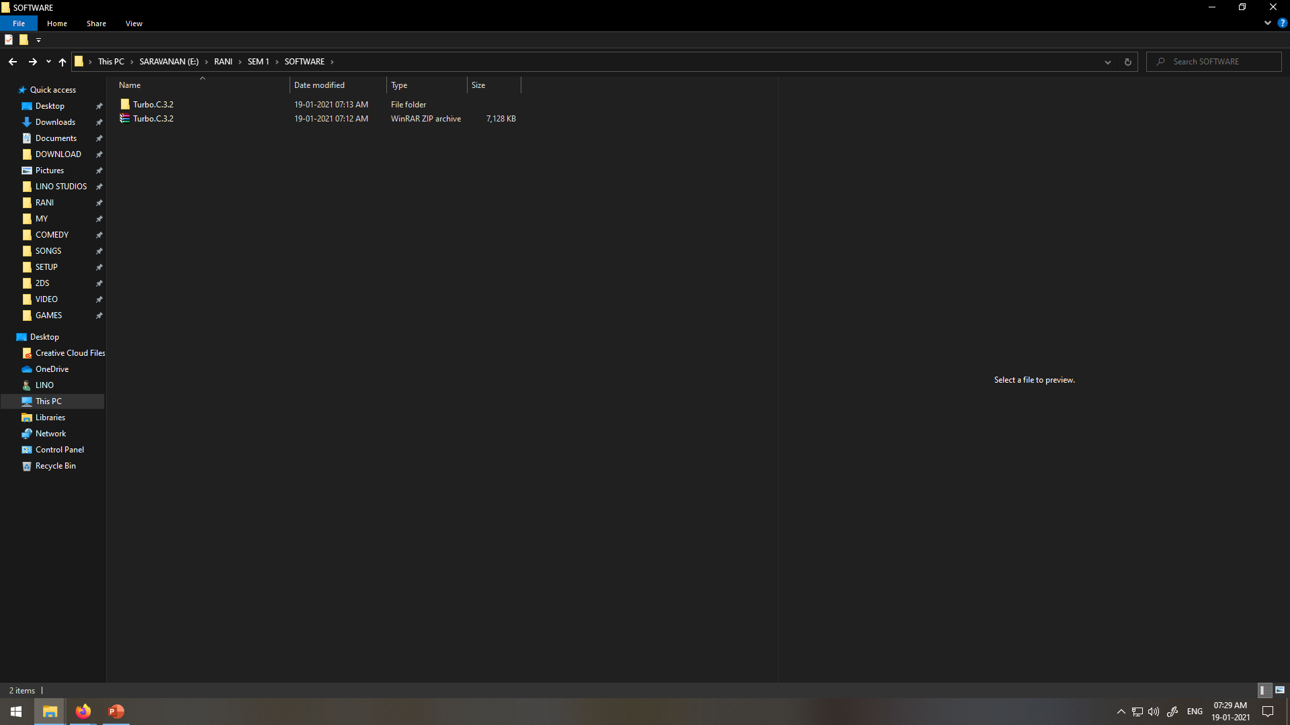
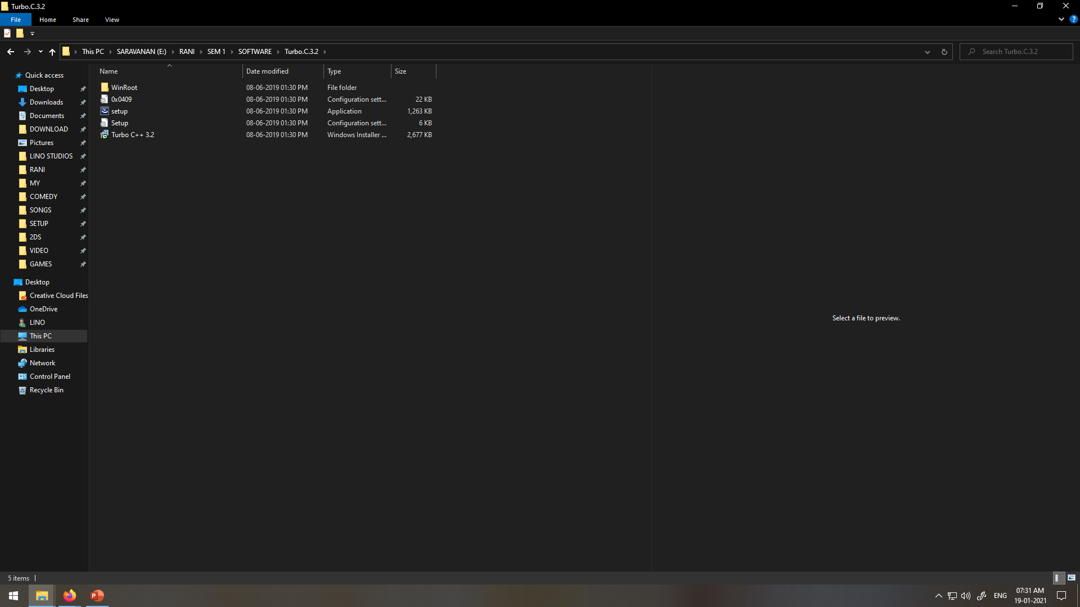
Open extracted folder(Double click on the folder)
Double click on the setup i.e application

Slide 30
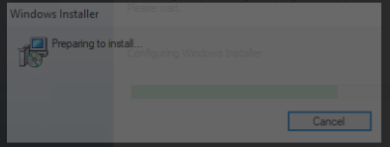
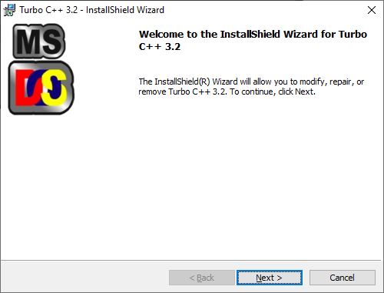
Select accept radiobutton and click install→ Click Launch

Slide 31
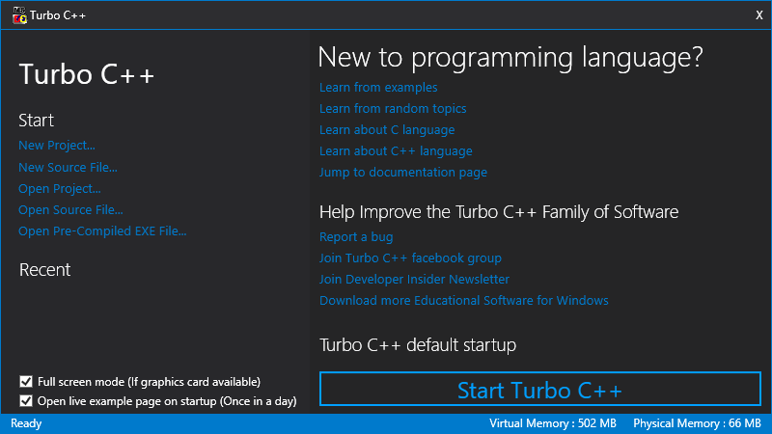

Slide 32
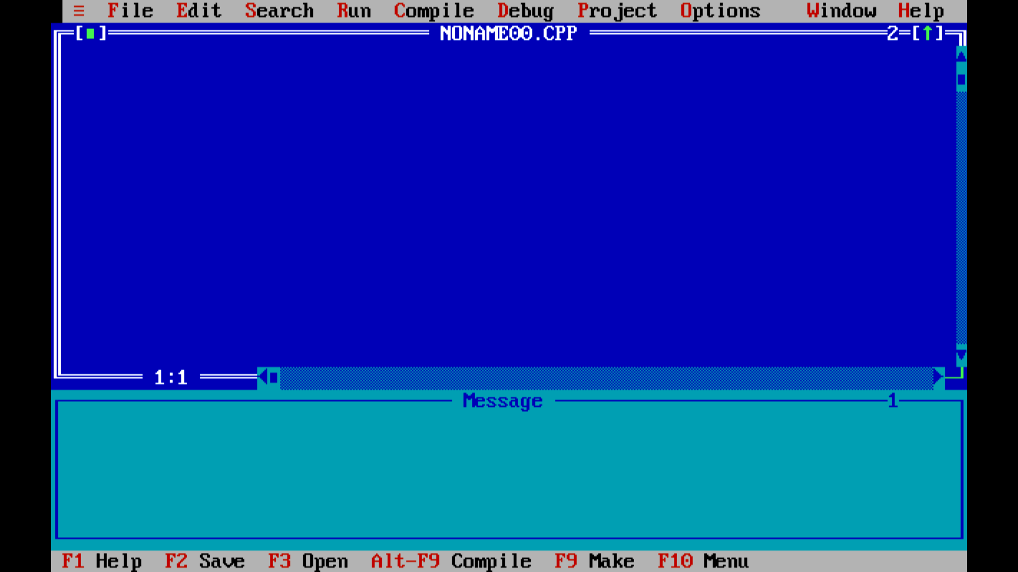

Slide 33
Tokens in C++
Each word or statement and punctuation is referred to as a token in C++.
Tokens are the smallest building block or smallest unit of a C++ program.
Keywords
Keywords are reserved words which convey special meaning to compiler or computer program, and its meaning cannot be changed.
The meaning and working of these keywords are already known to the compiler.

Slide 34
DATATYPES(kEYWORDS)
Keywords are the words that Convey Special meaning to the language compiler
The three basic data types are
INTEGER
These are whole numbers, both positive and negative
int
FLOATING POINT
These are numbers which contain fractional parts, both positive and negative.
float

Slide 35
CHARACTER
These are single characters.
char
Double
These are numbers which contain decimal values.
double

Slide 36
2. Comments in C++
Single line comment:
Syntax:
// a comment
Multi-line comment
/* a comment*/

Slide 37
2. VARIABLE(Identifiers)
Identifiers are names given to different entity such as variables, structures, and functions. Also, identifier names should have to be unique name.
Variables must be declared before they can be used in a program.
Used to Store values
Identifier naming conventions or rules
1. Only alphabetic characters, digits and underscores are permitted.
2. First letter must be an alphabet or underscore (_).
3. Identifiers are case sensitive.
4. Reserved keywords can not be used as an identifier's name.

Slide 38
Valid declaration:-
int newvar;
int _newvar;
int new_var;
Invalid declaration:-
int 1newvar;
int float;
int new-var;

Slide 39
Local variables
Only exist inside the specific function.
They are unknown to other functions.
They are recreated each time a function is executed or called.
Global variables
These variables can be accessed by any function in the program.
They do not get recreated if the function is recalled.

Slide 40
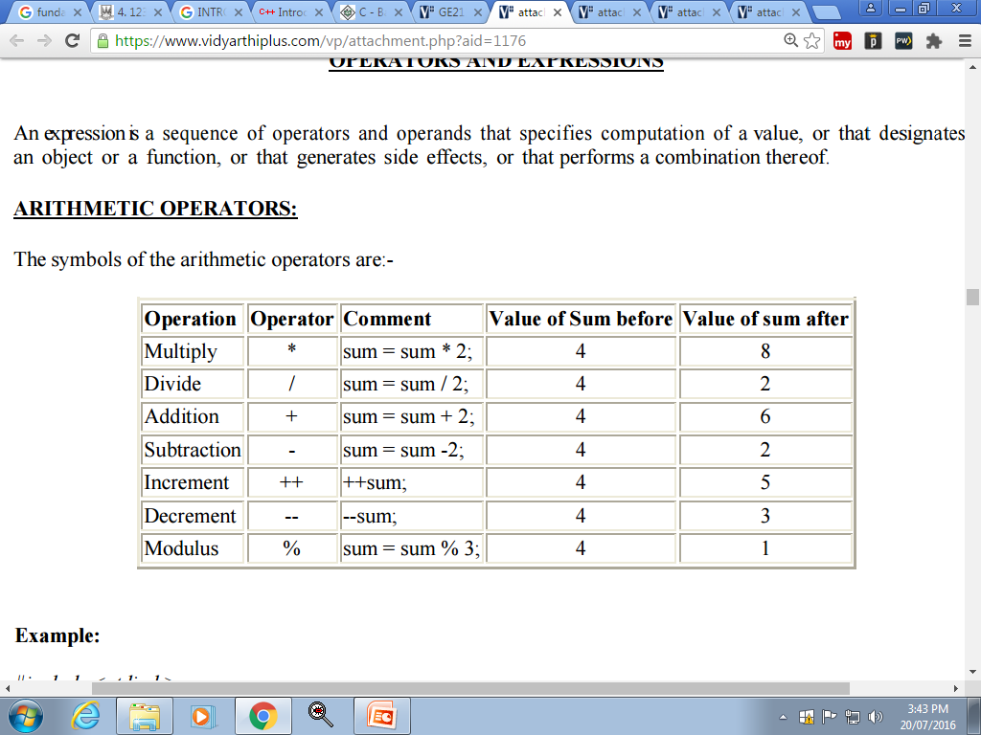
3. OPERATORS AND EXPRESSIONS
a. ARITHMETIC OPERATORS:
The symbols of the arithmetic operators are:-

Slide 41
b. THE RELATIONAL OPERATORS
These allow the comparison of two or more variables.
== equal to
!= not equal
< less than
<= less than or equal to
> greater than
>= greater than or equal to

Slide 42
c. THE I/O OPERATORS
Insertion(>>) :cin
Extraction(<<):cout

Slide 43
d. C++ Logical Operators
Logical operators are used to check whether an expression is true or false.
If the expression is true, it returns 1 whereas if the expression is false, it returns 0.
Operator | Example | Meaning
&& | expression1 && expression2 | Logical AND. True only if all the operands are true.
|| | expression1 || expression2 | Logical OR. True if at least one of the operands is true.
! | !expression | Logical NOT. True only if the operand is false.

Slide 44
Classwork:
C++ Program to Print Number Entered by User
C++ Program to Add Two Numbers
C++ Program to Find Quotient and Remainder
C++ Program to Swap Two Numbers
C++ Program to Find Size of int, float, double and char in Your System
Homework:
C++ Program to calculate average marks of five subjects entered by user.

